Slide 1
Lecture 14
Counting

Slide 2
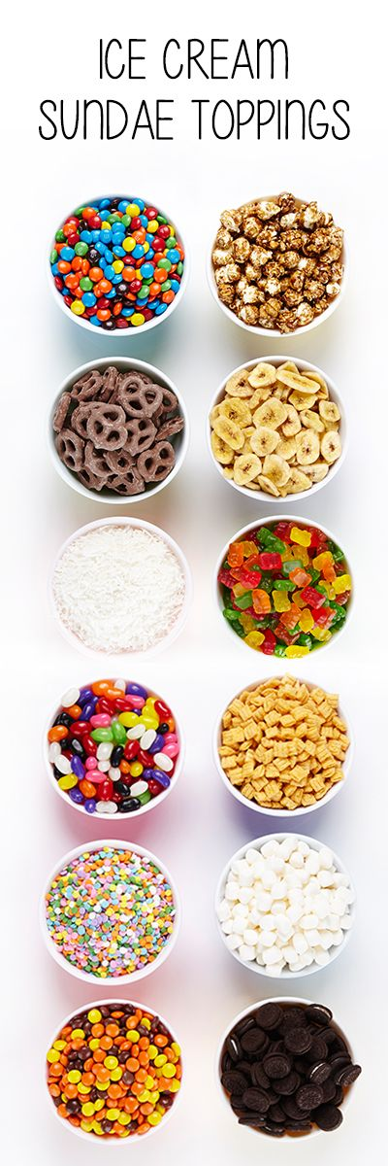

COUNTING PRINCIPLE
An ice cream shop offers 16 flavors of ice cream and 12 toppings. How many different sundaes can the shop make using 1 flavor and 1 topping?
ICE CREAM FLAVORS
16 x 12 = 192

Slide 3
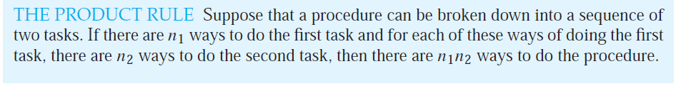
COUNTING PRINCIPLE the Product RULE

Slide 4
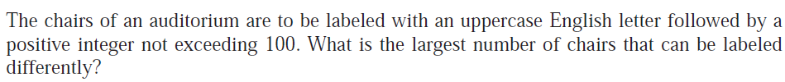
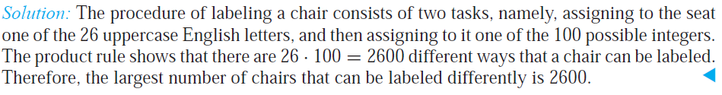
COUNTING PRINCIPLE the Product RULE - EXMPLES

Slide 5
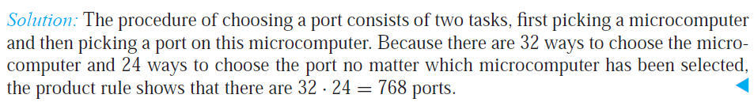

COUNTING PRINCIPLE the Product RULE - EXMPLES

Slide 6
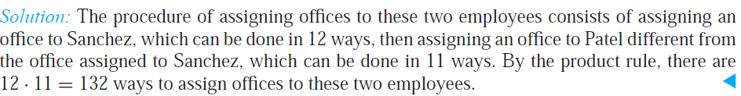
COUNTING PRINCIPLE the Product RULE - EXMPLES

Slide 7
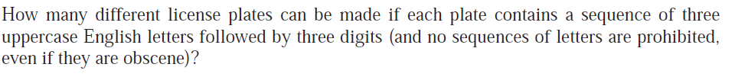
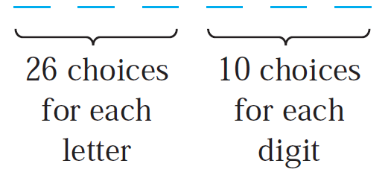
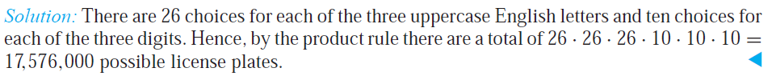
COUNTING PRINCIPLE the Product RULE - EXMPLES

Slide 8
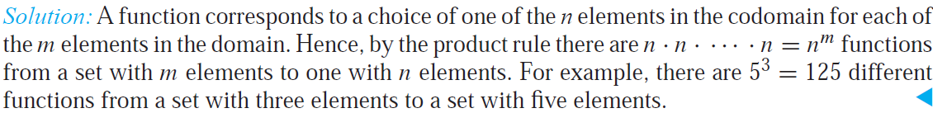
COUNTING PRINCIPLE the Product RULE - EXMPLES

Slide 9
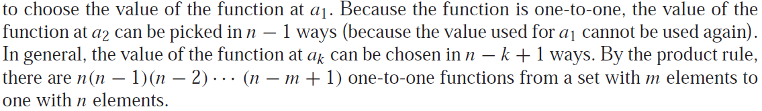
COUNTING PRINCIPLE the Product RULE - EXMPLES
How many one-to-one functions can be formed from a set with three elements to a set with five elements?
5 · 4 · 3 = 60

Slide 10
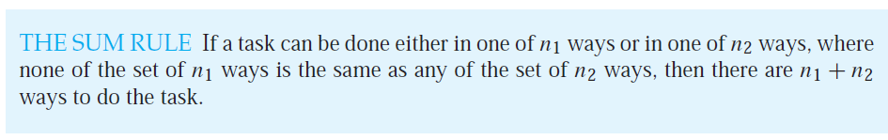
COUNTING PRINCIPLE the SUM RULE
EXAMPLE : Suppose there are 7 different optional courses in Computer Science and 3 different optional courses in Mathematics.
Then there are 7 + 3 = 10 choices for a student who wants to take one optional course.

Slide 11
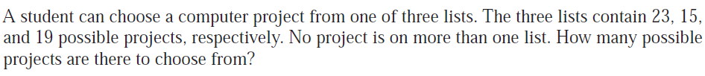
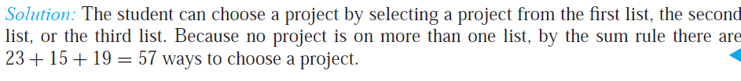
COUNTING PRINCIPLE the SUM RULE : EXAMPLES
EXAMPLE : There are 18 math majors and 25 CS majors. How many ways are there to pick one math major or one CS major?
Total is 18 + 25 = 43

Slide 12
tree diagrams
Counting problems can be solved using tree diagrams.
A tree consists of
a root,
number of branches leaving the root, and
possible additional branches leaving the endpoints of other branches.
Branch represents each possible choice.
Leaves represents possible outcomes, which are the endpoints of branches not having other branches starting at them.

Slide 13
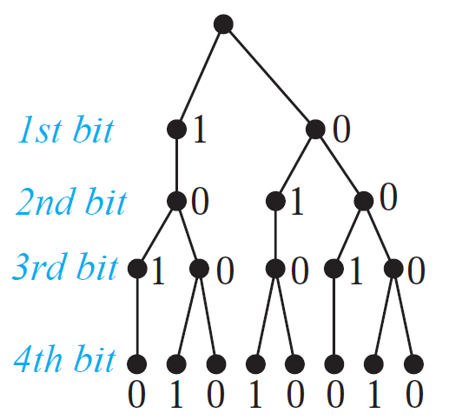

tree diagrams Example
How many bit strings of length four do not have two consecutive 1s?
The tree diagram in displays all bit strings of length four without two consecutive 1s.We see that there are eight bit strings of length four without two consecutive 1s.

Slide 14
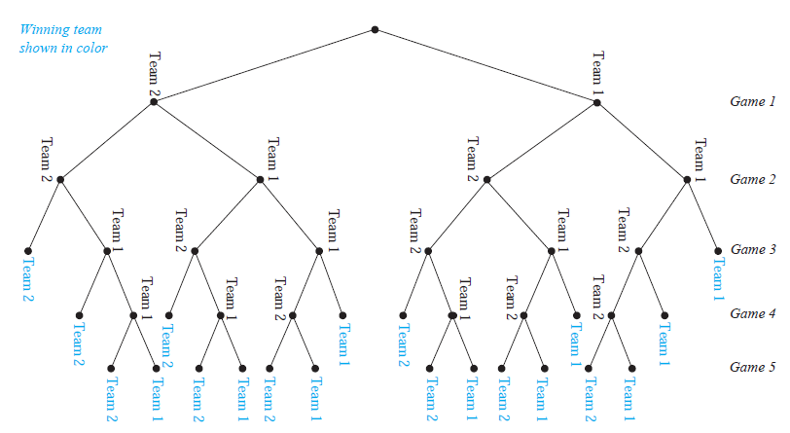
tree diagrams Example
A playoff between two teams consists of at most five games. The first team that wins three games wins the playoff. In how many different ways can the playoff occur?
The tree diagram displays all the ways the playoff can proceed, with the
winner of each game shown. We see that there are 20 different ways for the playoff to occur.

Slide 15
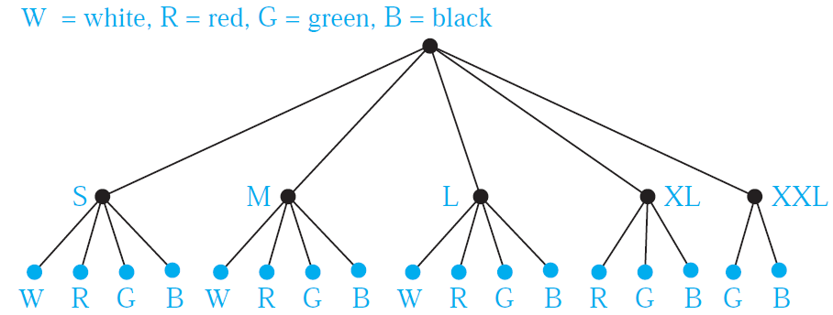
tree diagrams Example
Suppose that “I Love New Jersey” T-shirts come in five different sizes: S, M, L, XL, and XXL. Further suppose that each size comes in four colors, white, red, green, and black, except for XL, which comes only in red, green, and black, and XXL, which comes only in green and black. How many different shirts does a souvenir shop have to stock to have at least one of each available size and color of the T-shirt?
The tree diagram displays all possible size and color pairs. It follows that the souvenir shop owner needs to stock 17 different T-shirts.

